Slide 1
Homework 1
COSE331 Computer Graphics

Slide 2
Goal
Setting up Android Studio development environment
Filling in some lines in the vertex shader
Vertex position
Vertex normal
Texture coordinates
Filling in lines in the functions of the scene class in GL program

Slide 3
Android Studio
Android Studio is the official integrated development environment (IDE) for the Android platform.
Android Studio can be downloaded from the official website. [link]

Slide 4
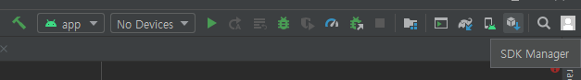
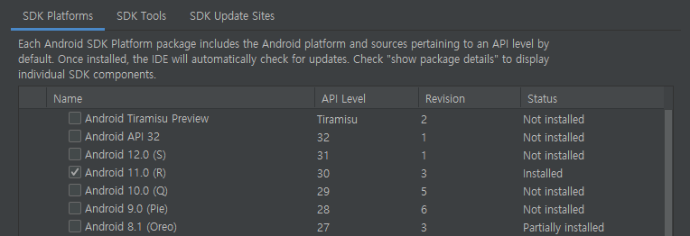
Android SDK
Android SDK can be installed through the SDK Manager in Android Studio.
Use SDK API level 30

Slide 5
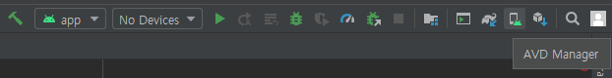
Android SDK
You may need to install additional platforms to try USB debugging on your smartphone.
Or you can use Android Virtual Device (AVD).
To use AVD, you need to enable hardware virtualization technology (shown as VT-x or SVM) in BIOS settings.

Slide 6
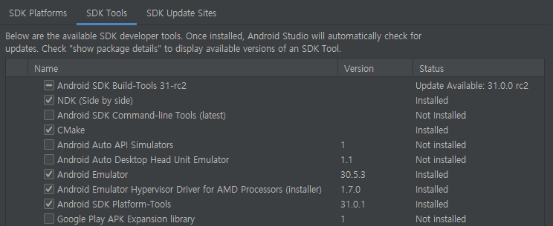
Android SDK
To use C++ native language on Android, you need to install the following tools.
CMake
NDK (Use version 19.2.5345600)

Slide 7
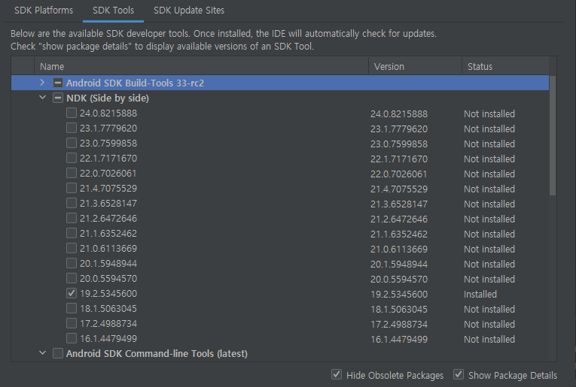
Android SDK
Use NDK version 19.2.5345600.

Slide 8
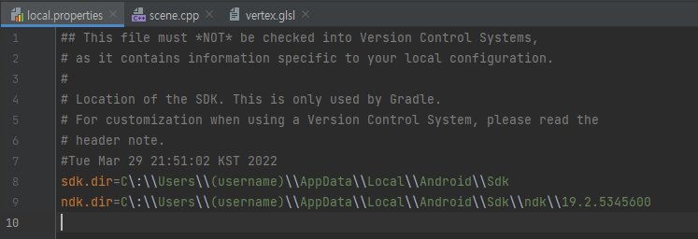
Gradle Sync
Before doing homework, you have to modify local.properties file.
Change (username) of ndk.dir and sdk.dir to your PC username.
Use the following path for MacOS device.
sdk.dir=/Users/(username)/Library/Android/sdk
ndk.dir=/Users/(username)/Library/Android/sdk/ndk/19.2.5345600

Slide 9
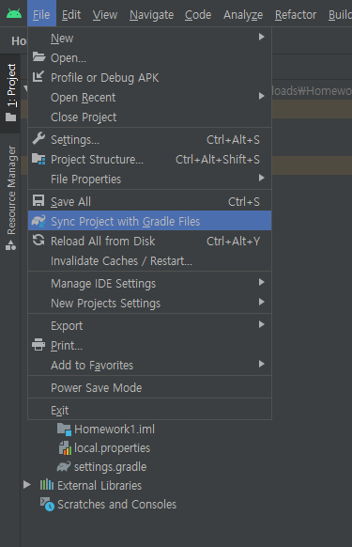
Gradle Sync
After modifying, sync project with gradle files.
Files – Sync Project with Gradle Files

Slide 10
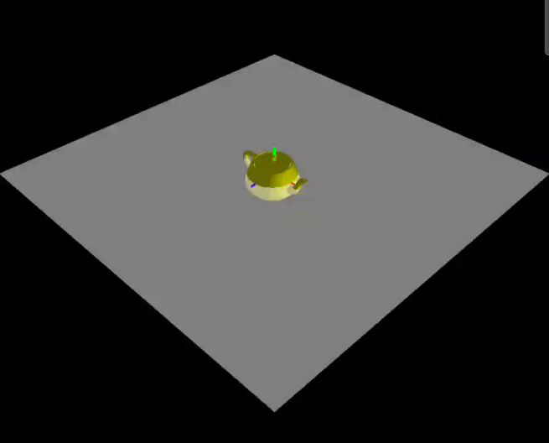
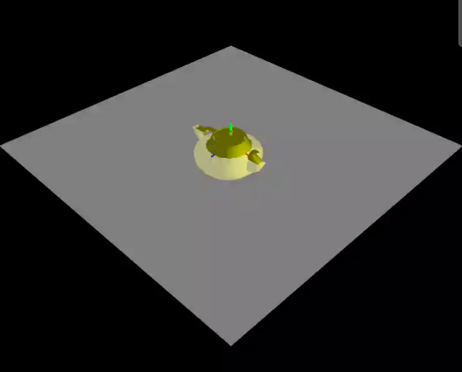
Problem 1
clip-space vertex position과 world-space vertex normal을 계산한다.
texture coordinates는 그대로 rasterizer로 전달된다.
회색 평면 아래의 주전자 부분을 1.5배 확대한다.
회색 평면은 월드 공간의 XZ 평면을 나타낸다.

Slide 11
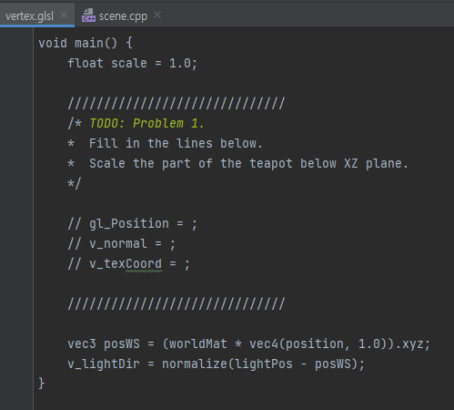
Problem 1
Fill in some lines in the vertex shader.
app/src/main/assets/vertex.glsl

Slide 12
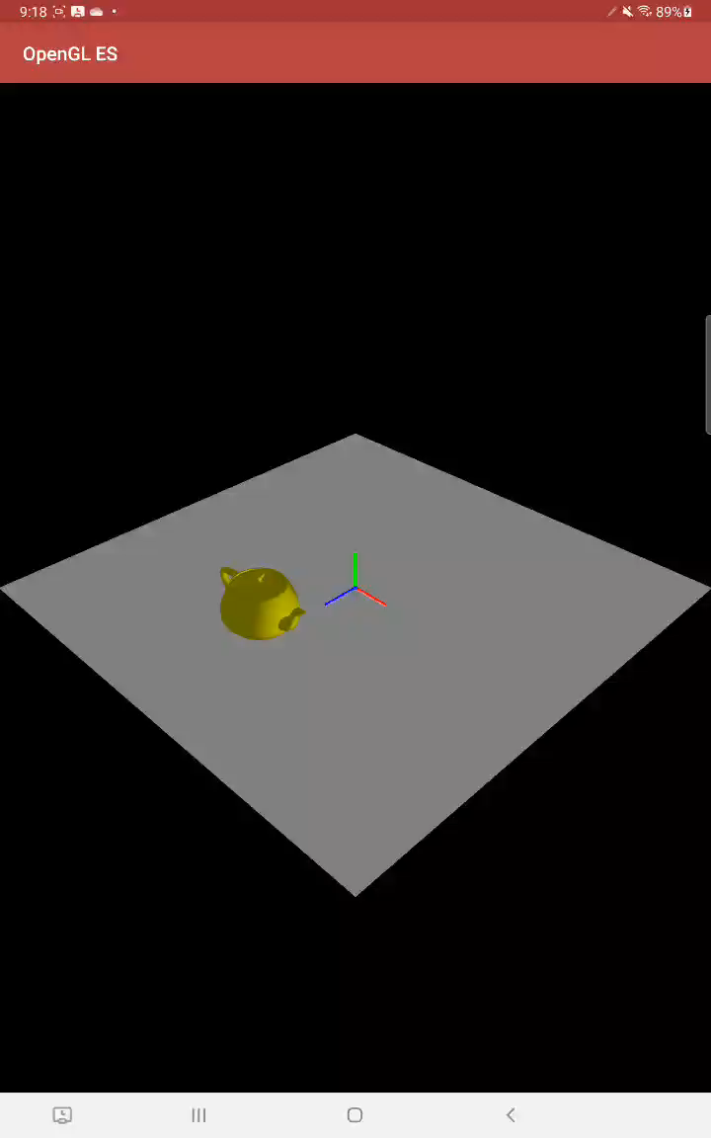
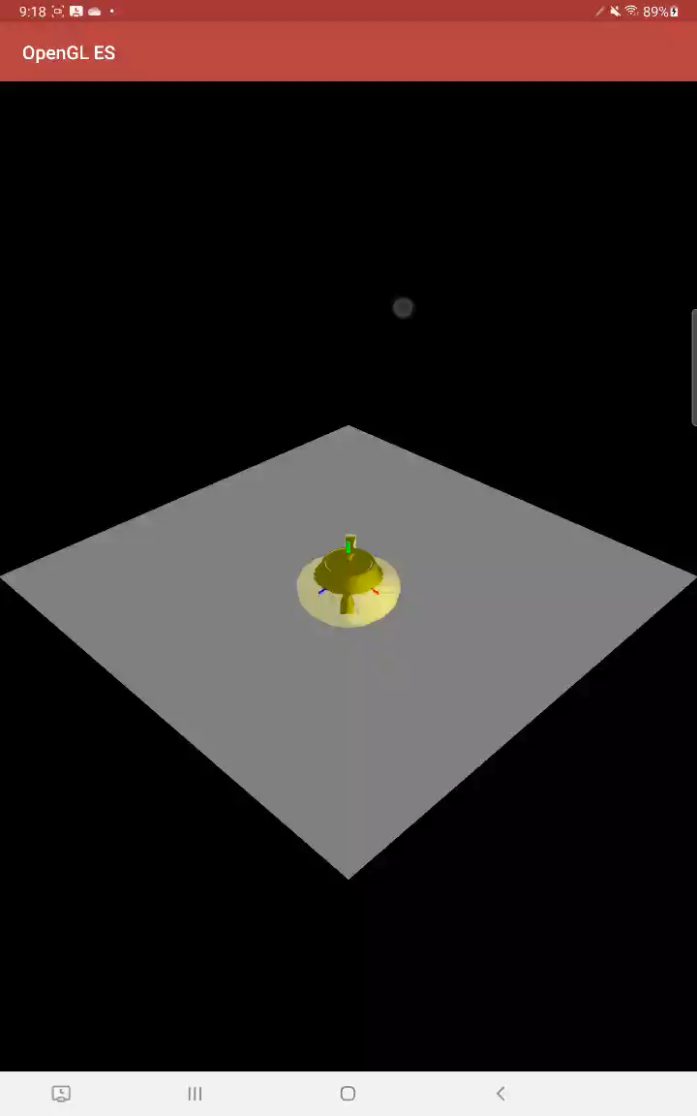
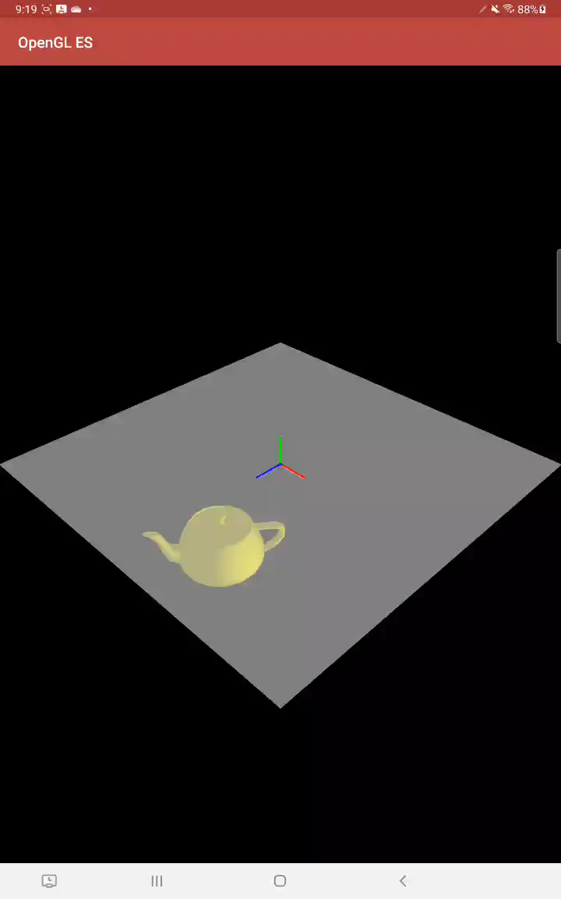
Problem 2
주전자의 공전과 자전을 구현한다.
YZ 평면 위의 원 궤도로 움직이는 공전을 구현한다.
주전자의 Y축을 회전 축으로 하는 자전을 구현한다.
공전 주기는 자전 주기의 2배이다.(자전이 2번 일어날 때 공전이 1번 일어난다)

Slide 13
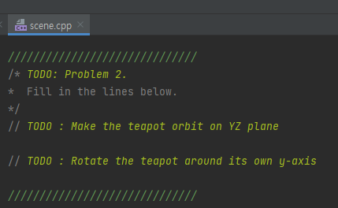
Problem 2
Fill in some lines in Scene::update(…).
app/src/main/cpp/scene.cpp

Slide 14
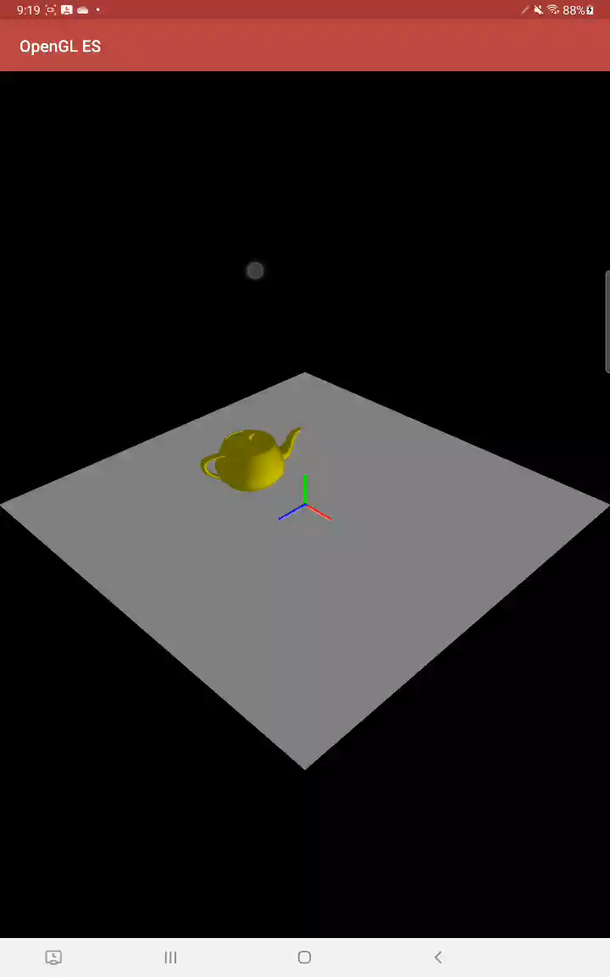
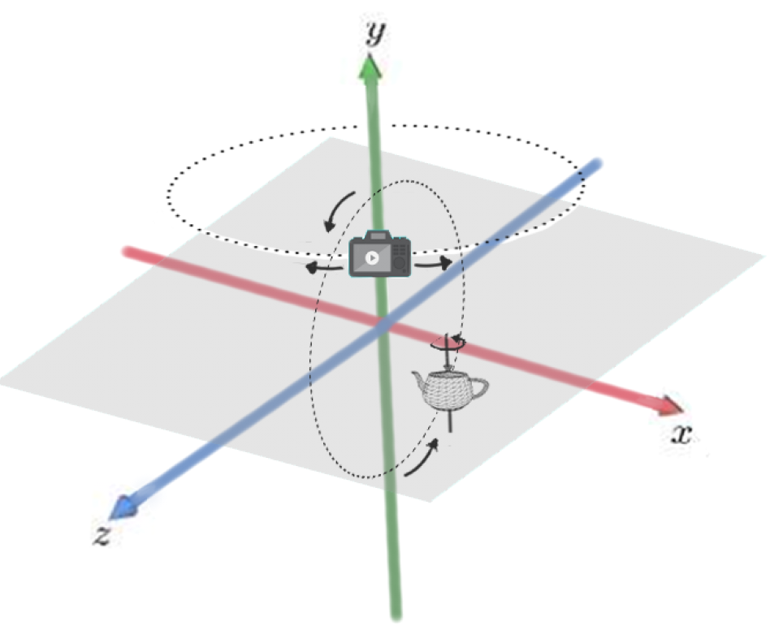
Problem 3
화면을 좌우로 드래그할 때, 움직이는 카메라를 구현한다.
카메라는 Y축을 중심으로 XZ 평면과 평행한 원 궤도로 움직인다.
카메라의 Y 좌표는 변하지 않는다.

Slide 15
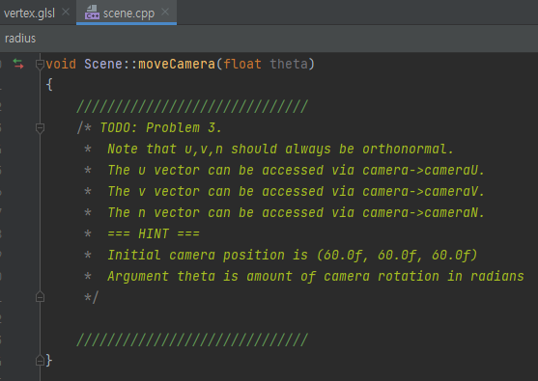
Problem 3
Fill in some lines in Scene::moveCamera(…).
app/src/main/cpp/scene.cpp

Slide 16
GLM Library
You may use some glm functions.
glm::cross(…)
glm::normalize(…)
glm::translate(…)
glm::rotate(…)
You may use some pre-defined variables in scene.cpp
time : variable increasing over time
theta : amount of camera rotation, value for screen drag
radius : radius of the teapot’s orbit

Slide 17
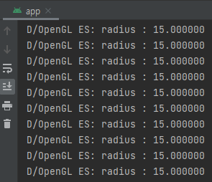
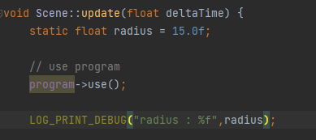
Debugging
You can use LOG_PRINT_DEBUG() for debugging purposes
example)

Slide 18
Submission
Deadline
April 17 (Mon) 14:00
Submission files ({student_id}_{name}.zip)
Vertex shader file (app/src/main/assets/vertex.glsl)
Scene class file (app/src/main/cpp/scene.cpp)
Submission to Blackboard
Contact
TA email: 2023.cg.ta@gmail.com

